Slide 1
Thriving at Home: Health & Wellness Strategies for Remote Work
HRMN 1008: Training and Development

Slide 2
Team Members
Gurwinder Singh
Manpreet Kaur
Rahul Gupta
Sukhminder Kaur

Slide 3

Land Acknowledgement
Georgian College recognizes the pre-17th-century ancestral territories of the Wendat Nation and the Three Fires Confederacy, which comprised the Odawa, Ojibwe, and Pottawatomi people. Respecting and mending connections with First Nations, Métis, and Inuit people is how the college demonstrates its commitment to rapprochement. Its curriculum will incorporate Indigenous viewpoints and acknowledge historical injustices, as well as promote cultural awareness. An open atmosphere that honors Indigenous heritage and culture is fostered at Georgian College. Incorporating these values into its operations and instructional strategies, the institution supports larger national reconciliation activities that promote mutual respect, understanding, and collaboration with Indigenous populations

Slide 4

Introduction
Thank you for selecting WellnessWorks Training Solutions to address the critical issue of health and wellness in the context of remote work.”
"In 2024, remote work has significantly shaped the modern workplace, with 42% of U.S. workers now working from home full time.”
"Our goal today is to provide you with practical strategies to enhance your health and wellness while working remotely.

Slide 5
Learning Outcomes
By the end of this session, you will be able to:
Identify and implement ergonomic practices to reduce physical health issues such as back and neck pain.
Learn effective stress management techniques to improve mental health.
Understand the importance of taking regular breaks and setting boundaries to maintain a healthy work-life balance.
Learn practical exercises and strategies to enhance overall health and wellness.
Recognize the benefits of maintaining a clean diet and learn how to plan and prepare nutritious meals.

Slide 6
Needs Analysis Summary
To understand the health and wellness needs of remote workers, we conducted a survey with 25 colleagues, receiving 19 responses.

Slide 7
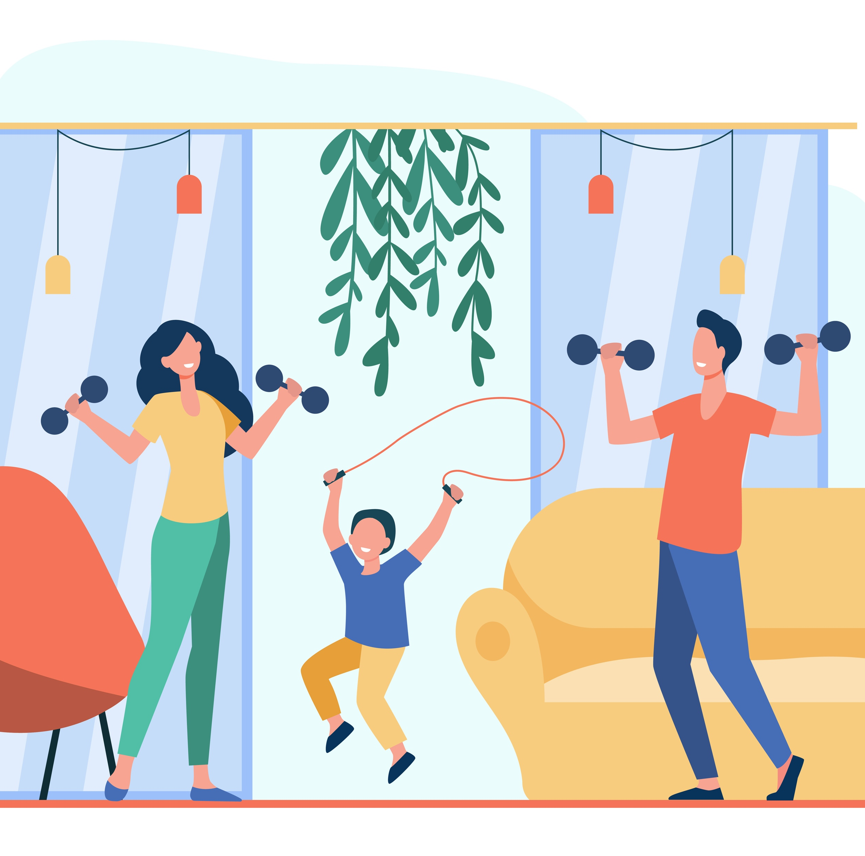
Physical Health Issues
58% reported back pain.
42% reported neck pain.
37% experienced eye strain.
53% reported weight gain.

Slide 8
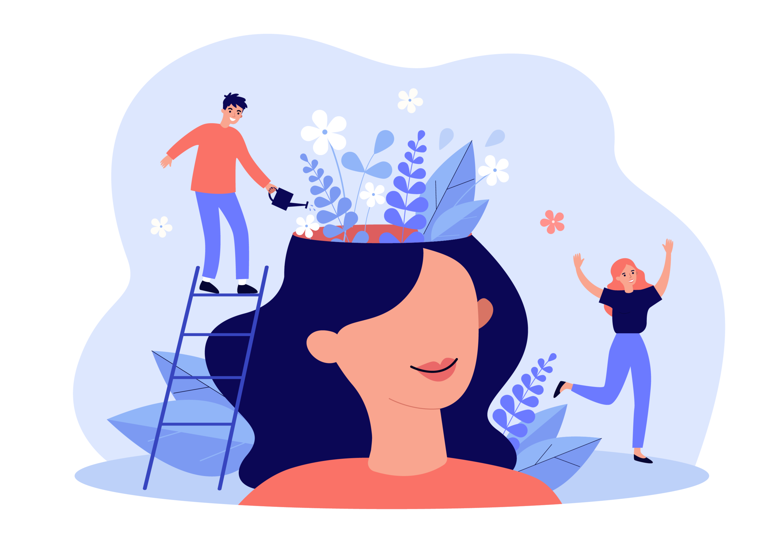
Mental Health Issues
47% rated their mental health as fair.
37% reported increased stress.
16% experienced anxiety.
21% experienced depression.

Slide 9

Break Frequency and Boundaries
Only 26% take breaks every hour.
37% set boundaries, but 11% struggle to maintain them.

Slide 10
Key Findings and Recommendations
Our findings indicate significant physical and mental health challenges for remote workers.
We recommend a comprehensive training program focusing on ergonomics, mental health, and effective work-life balance strategies.
This session will equip you with practical tools to enhance your well-being while working from home.
.

Slide 11
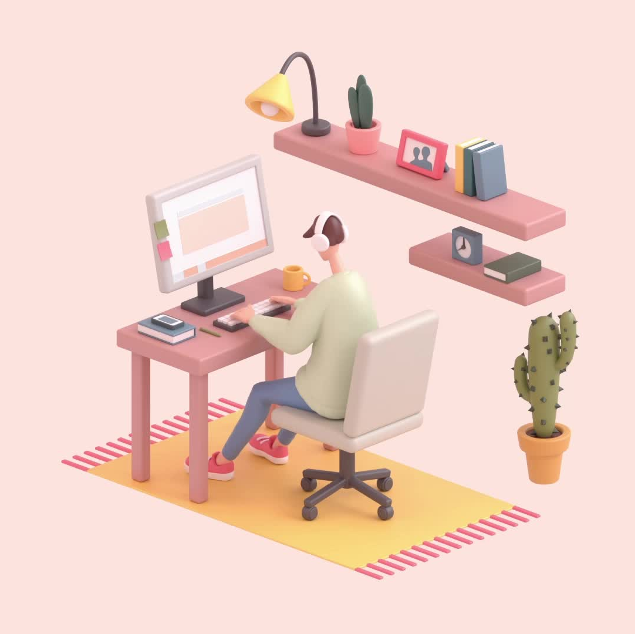
Physical Health Tips
When working remotely, having an ergonomic environment is essential for both productivity and physical well-being. By guaranteeing that your desk promotes healthy posture and lessens strain, proper ergonomics helps minimize pain and accidents. Important features include of:
Chair: Make sure your chair has height adjustment and lumbar support.
Desk: Set up so elbows are 90 degrees from the body.
To prevent neck discomfort, position the monitor at eye level.

Slide 12

Physical Health Tips
Morning Walks
Strengthens the heart and raises vitality.
Lowers tension and raises happiness.
Helps one to recharge and refocus by offering a natural pause from work

Slide 13
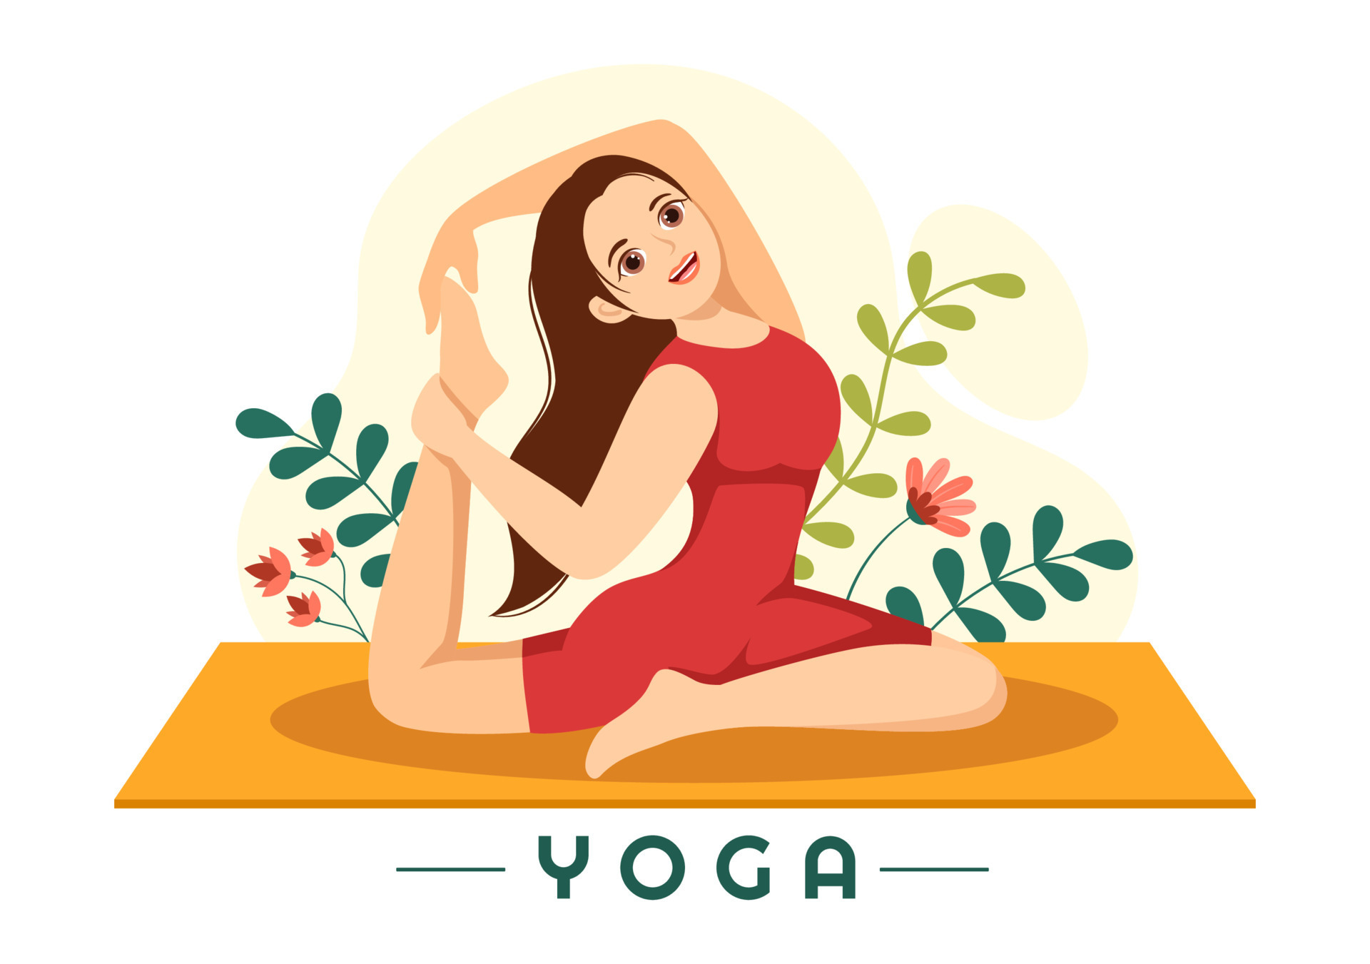
Physical Health Tips
Yoga
Increases the range of motion and flexibility.
Promotes relaxation and eases tense muscles.
Promotes balance between mental and physical health, which enhances overall well-being.

Slide 14
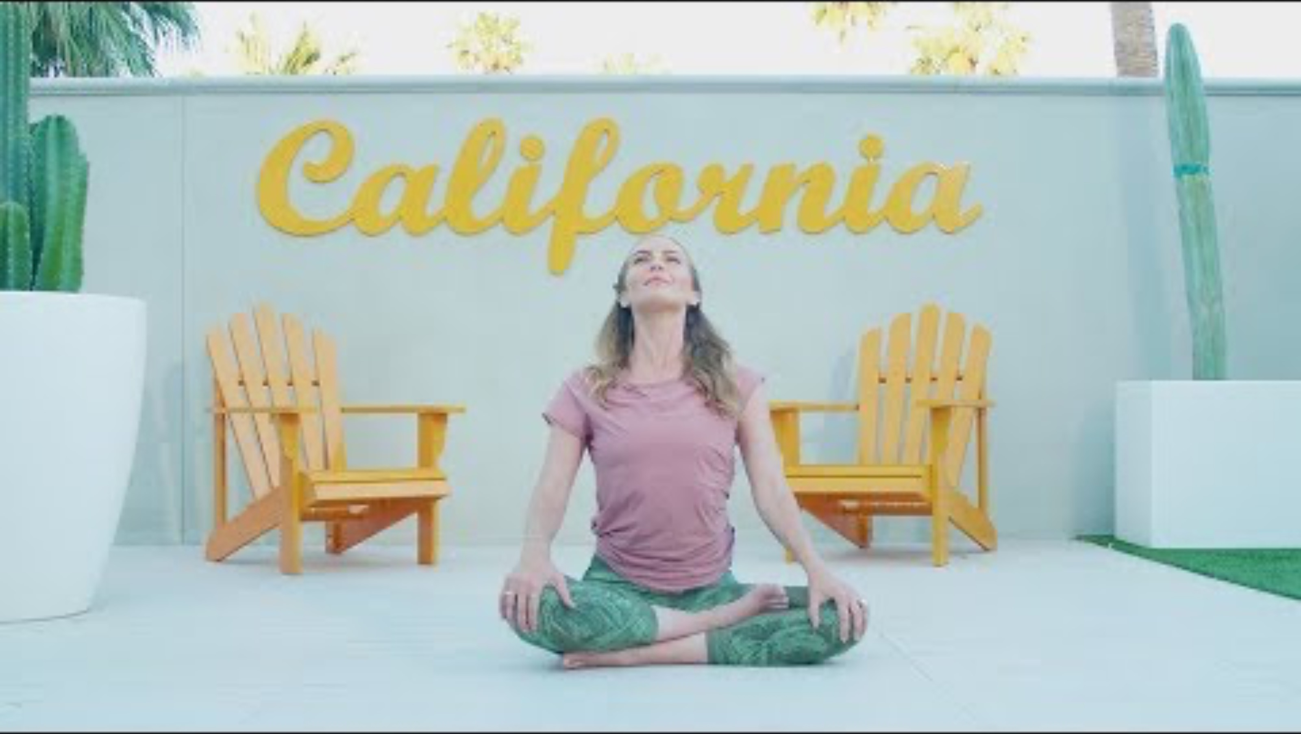
Quick 2-Minute Yoga Flow

Slide 15
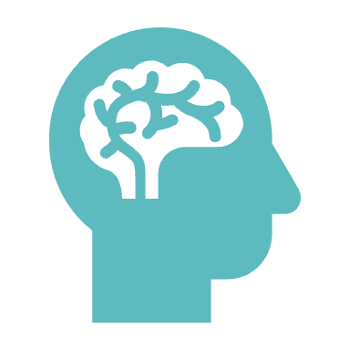
Challenges of remote work on Mental Health
Isolation: Feelings of alienation and loneliness can result from infrequent face-to-face contact.
Work-Life Balance: Stress levels might rise, and burnout can result from finding it difficult to maintain a healthy work-life balance.
Enhanced Stress: Trying to balance work and home obligations might be too much for some people, which can harm their mental health.

Slide 16
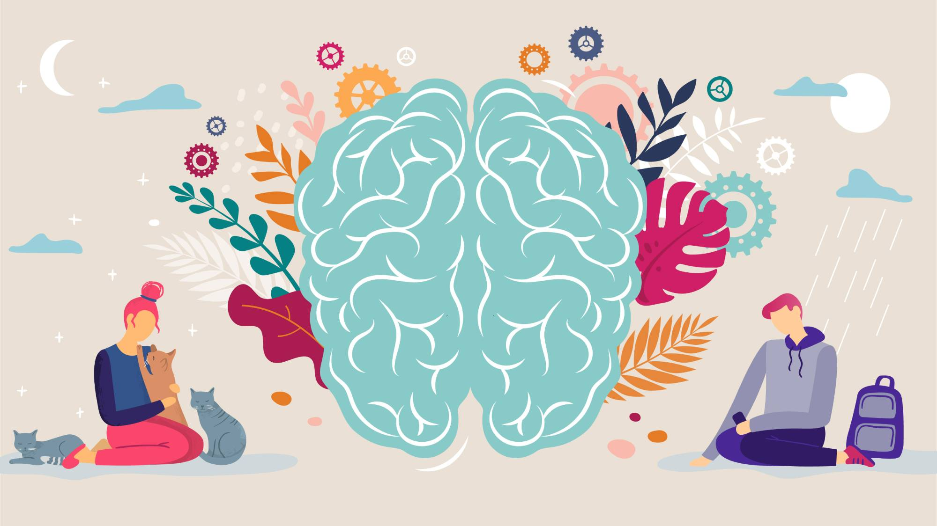
Techniques to Improve Mental Well-Being
Practices of Mindfulness: Try deep breathing, strolling with awareness, or meditation to lower stress and build emotional toughness.
Consistent Social Contacts: To prevent loneliness, stay in touch with friends and coworkers through social events or virtual meetings.
Determining Limits: Set up boundaries between work and personal time to avoid overworking yourself and to guarantee that you get enough sleep.

Slide 17

Reasoning Puzzle Challenge

Slide 18

Importance of Taking Breaks
Benefits of Short, Frequent Breaks
Short, frequent breaks are crucial for maintaining focus and preventing burnout. They help to:
Boost Productivity: Regular breaks prevent mental fatigue, allowing you to return to tasks with renewed energy and concentration.
Reduce Stress: Breaks provide a chance to relax and recharge, reducing overall stress levels and avoiding burnout.
Enhance Creativity: Stepping away from work can lead to better problem-solving and creative thinking as your brain processes information unconsciously.
Pomodoro Technique for Time Management
Working in concentrated 25-minute periods (called Pomodoros) and taking a 5-minute rest in between is known as the Pomodoro Technique. Four Pomodoros are followed by a longer (15–30 minute) rest. Incorporating frequent break times to reduce stress and prevent burnout, this technique aids in maintaining high levels of productivity and attention.

Slide 19

Nutrition and Productivity
Diet, Energy, and Productivity: The Connection
How Your Diet Impacts Energy and Productivity:
Nutrient-Rich Diets: Fuel sustained energy and cognitive performance. A balanced intake of vitamins, minerals, and other nutrients helps maintain steady energy levels throughout the day and enhances focus and efficiency.
Low-Nutrient Diets: Often lead to energy crashes and diminished attention. Insufficient nutrients can result in fatigue and decreased productivity

Slide 20

Healthy Choices: Breakfast: Greek yogurt with granola and strawberries for protein, fiber, and antioxidants. Lunch: Quinoa salad with chickpeas, veggies, and a vinaigrette for protein, good fats, and complex carbs. Tip: Balanced meals keep you energized and productive throughout the day!

Slide 21

Let's Play: Health and Wellness Essentials Quiz!
Join Kahoot:
Visit kahoot.it and enter the Game PIN.
Pick a nickname and get ready to play!
How to Play:
Answer questions on health and wellness quickly and accurately.
The faster you respond, the more points you earn.
Good luck, and let’s see who will be the health and wellness champion!

Slide 22
Conclusion
Key Points Synopsis
Healthy Living: To avoid strain and pain, keep your workstation ergonomic and include desk exercises.
Mental Well-Being: reduce stress and productivity by employing methods like the Pomodoro Technique to reduce anxiety and address the effects of isolation and work-life balance.
Pauses: To improve concentration, lower stress levels, and avoid burnout, take brief, regular pauses.
Nutrition: Consume healthfully prepared meals and snacks that enhance cognitive performance and offer long-lasting energy.
Motivating
To improve your remote work experience, make personal health objectives based on these ideas. Setting clear, attainable objectives will support you in maintaining a better and more productive work schedule, whether it involves changing your workstation, adding frequent breaks, engaging in mindfulness exercises, or making dietary improvements.

Slide 23
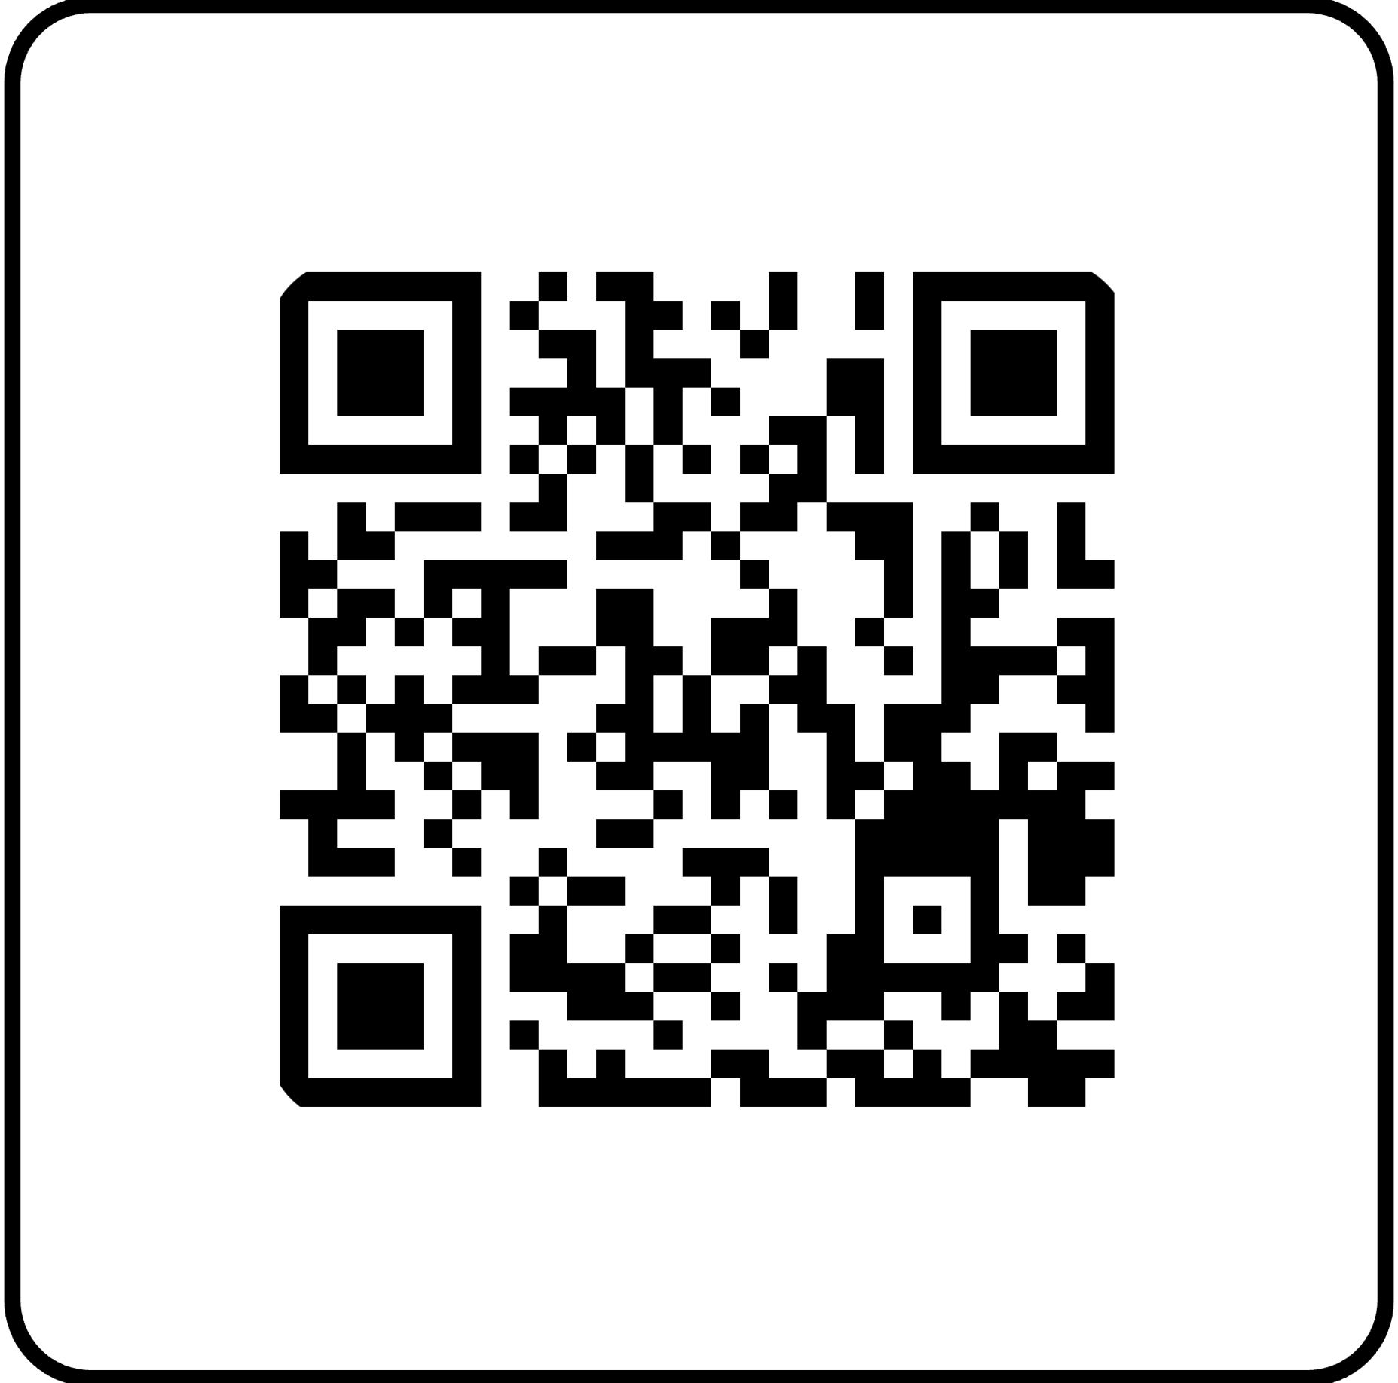
We Value Your Feedback

Slide 24

Thank you

